Slide 1
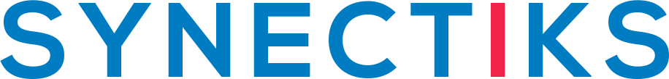
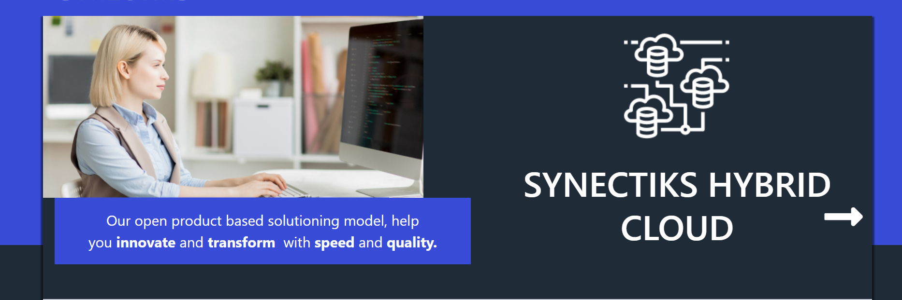
Our open product based solutioning model help 50% gain in time & effort ,to reduce your technical debt, get your apps and infrastructure ready for any cloud
© 2020 SYNECTIKS. All Rights Reserved. Proprietary and Confidential.

Slide 2
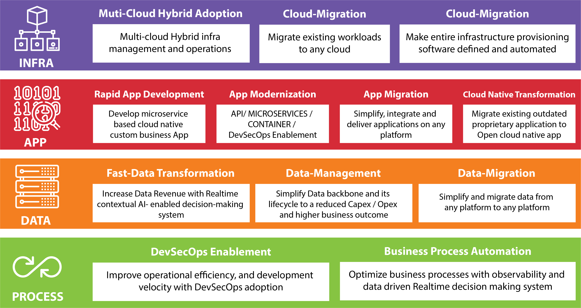
Capabilities

Slide 3
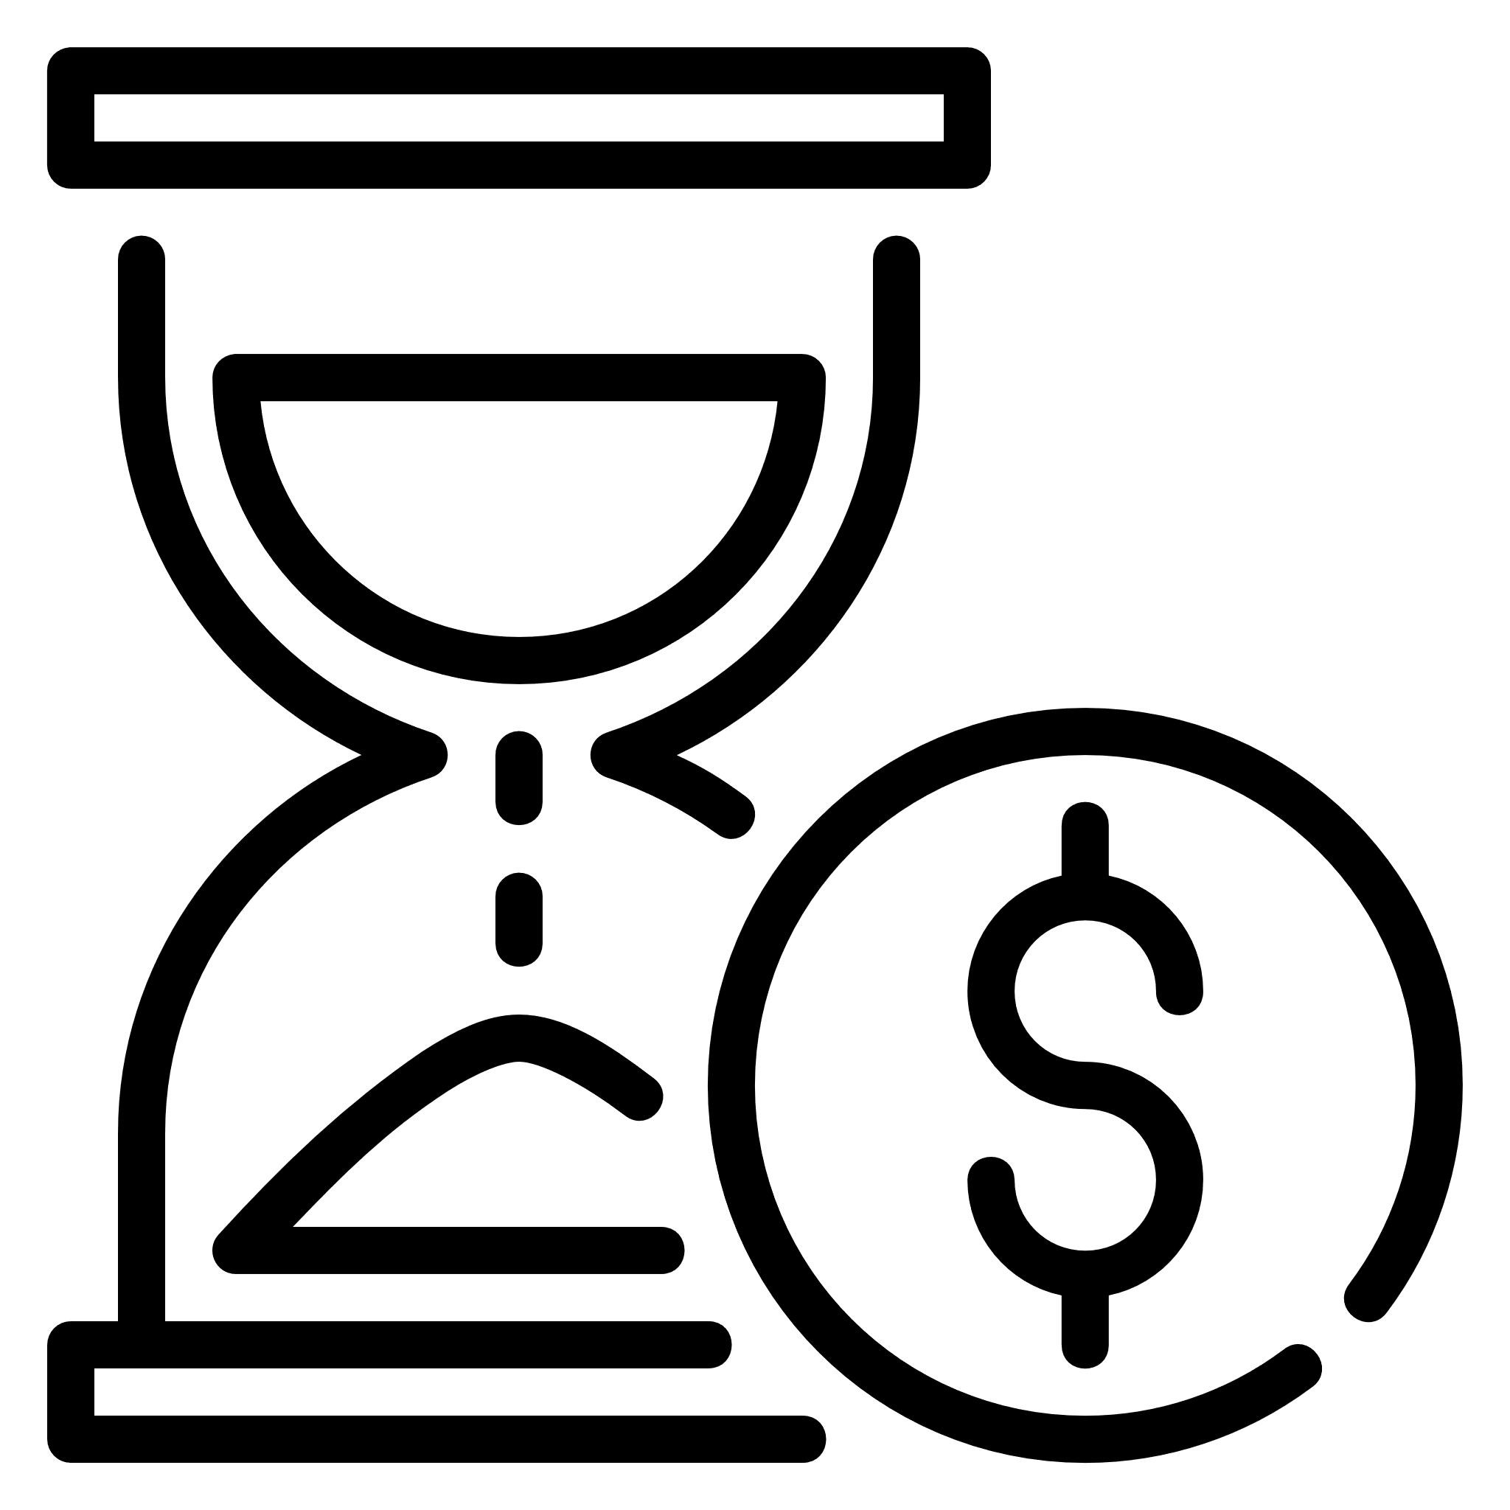


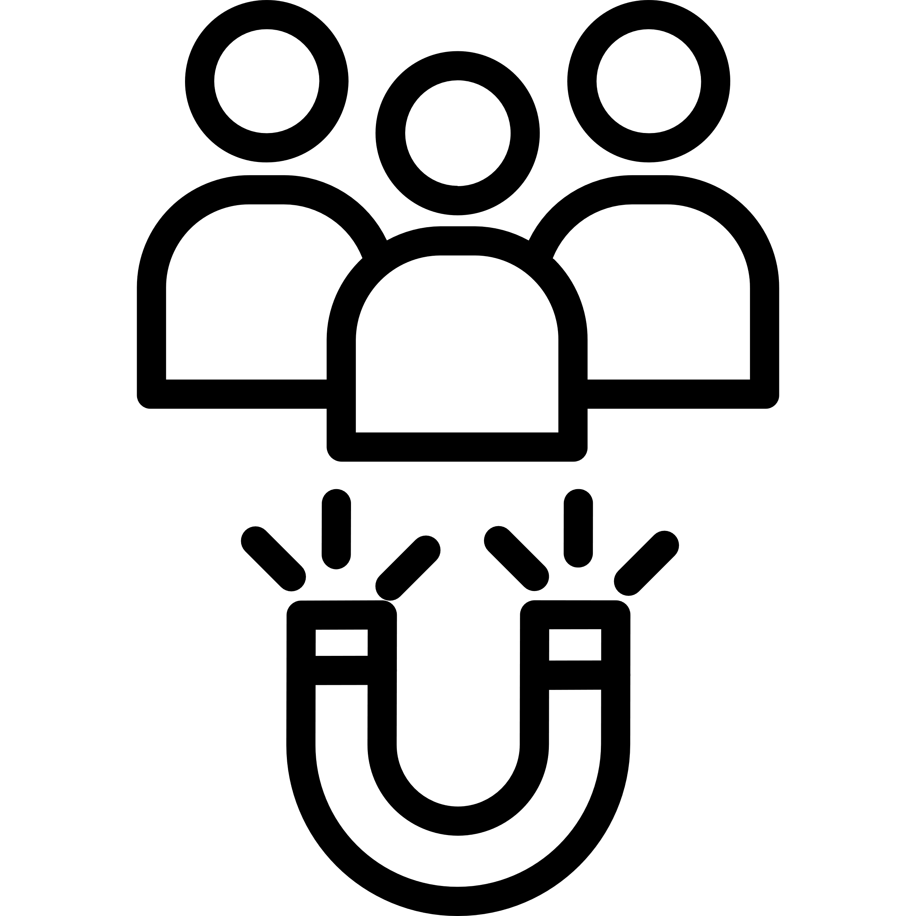
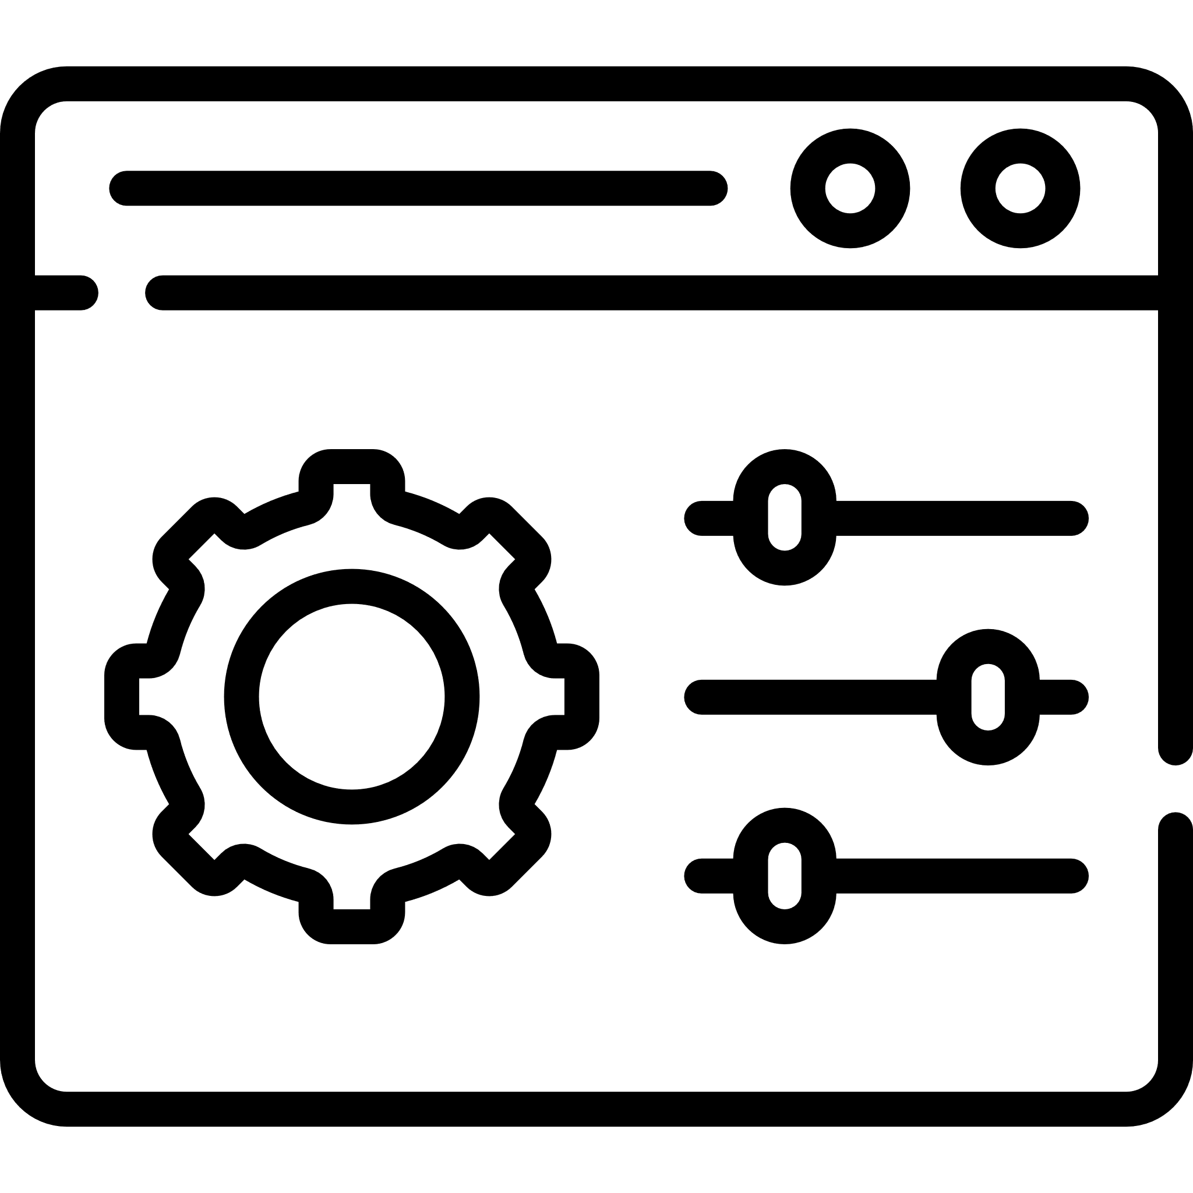
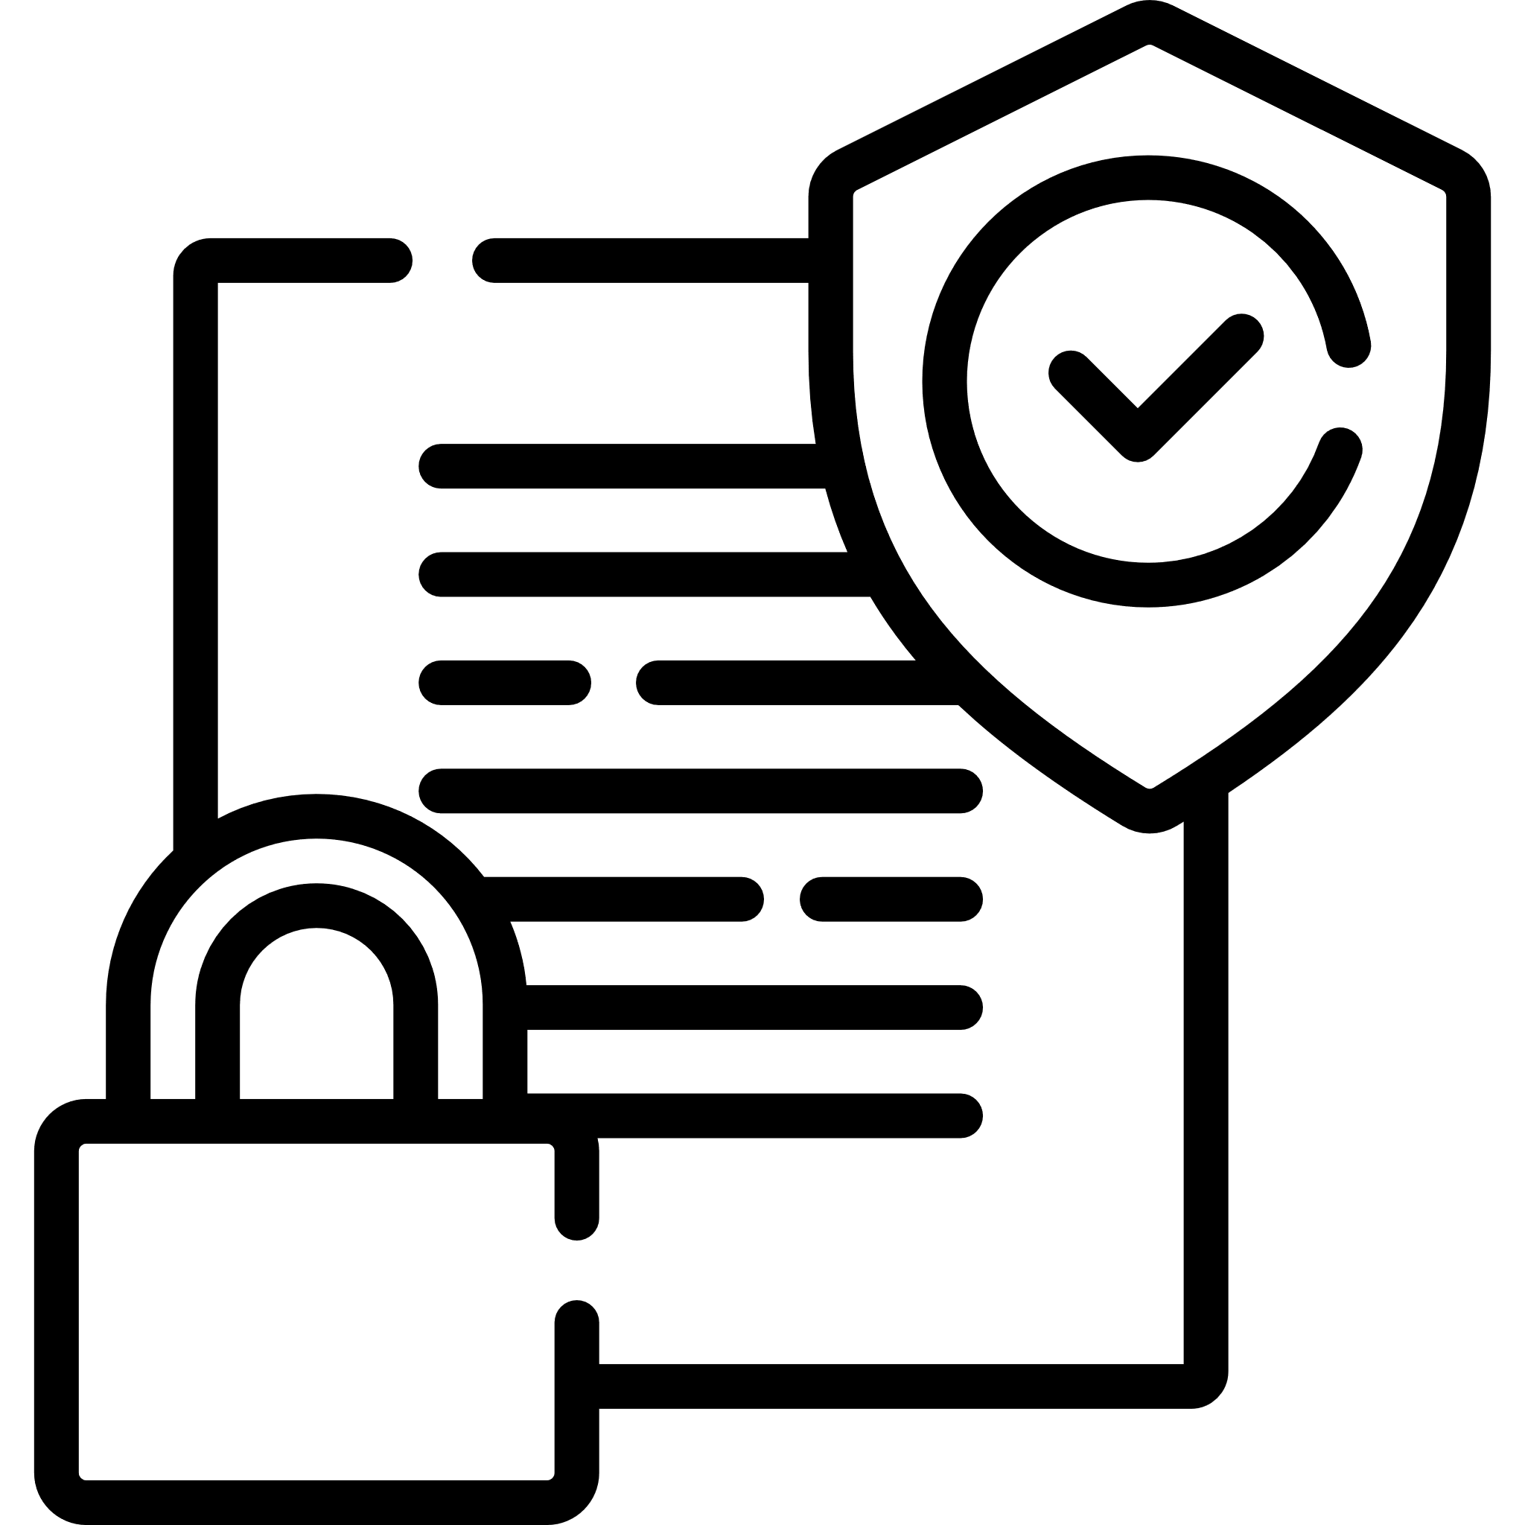
Differentiator
Time & Money
Experience
Expertise
Our open Product Driven Delivery
Model allows customers to
quickly build, deliver and
orchestrate cross cloud services
@50% time & cost
10+ Large Scale
Migration And Modernization
experience
Experience Team with a proven
track record of CloudOps delivery
enabled with DevSecOps
Capabilities
Long Term Retention
Single Control Panel
Compliance & Security
100% Customer Retention Rate
substantiated by excellent services
Xformation Product is a single
platform to manage all your
workloads distributed across
multiple clouds and boundaries
within a single control plane
Our compliance and security
assessment tools make sure
your hybrid cloud journey
meets your business compliance

Slide 4
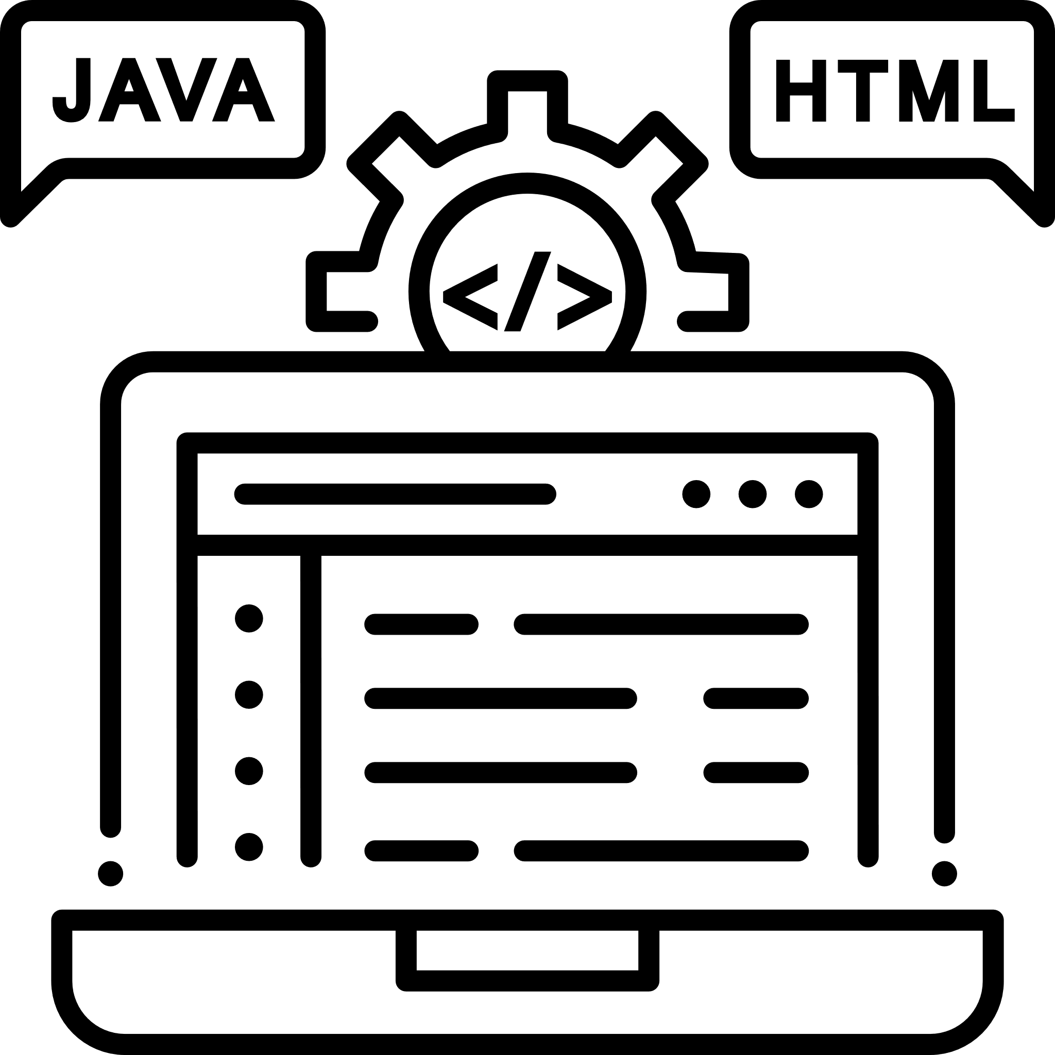
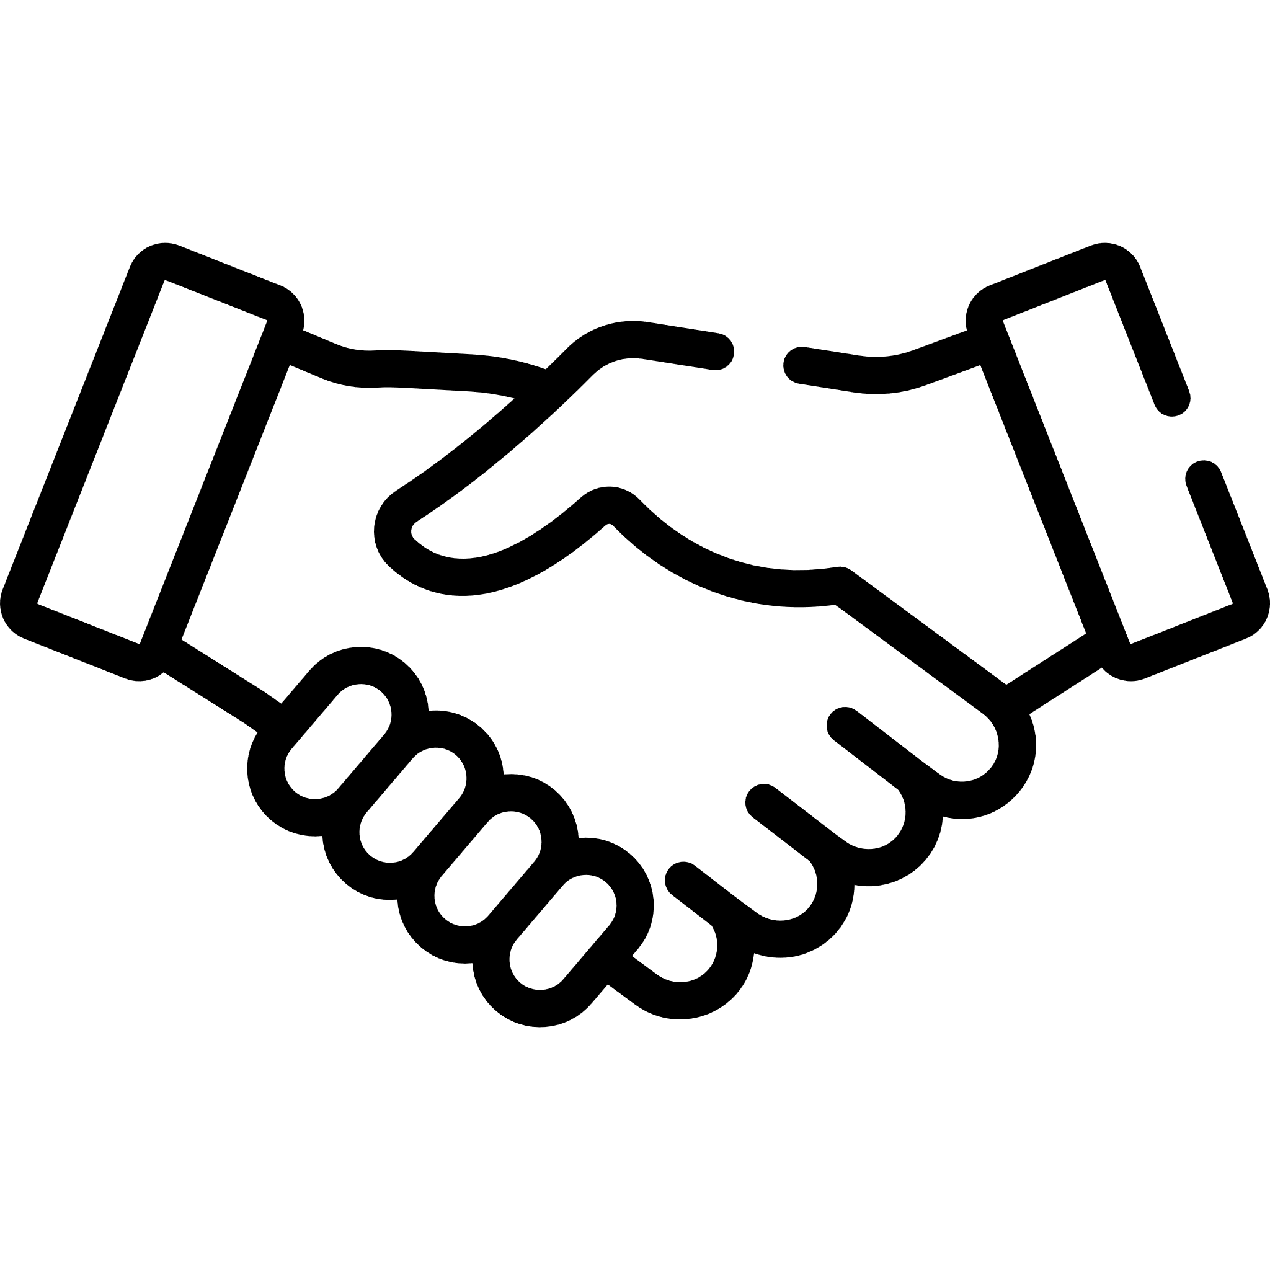
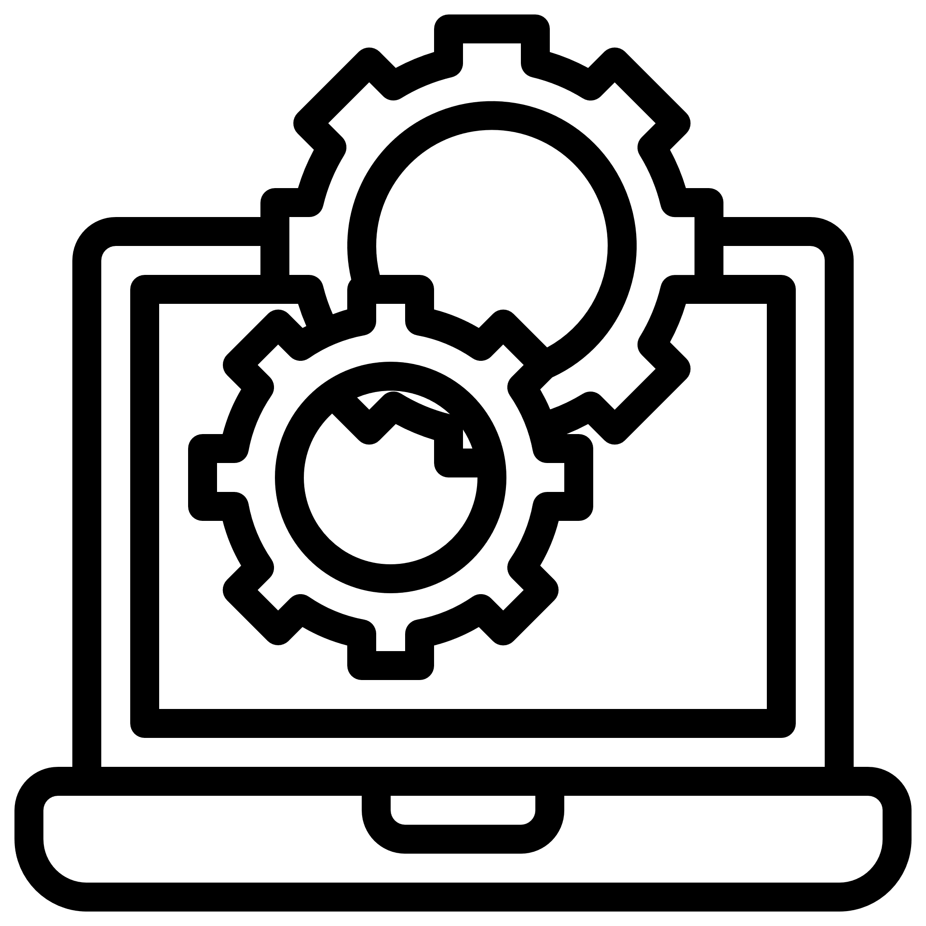
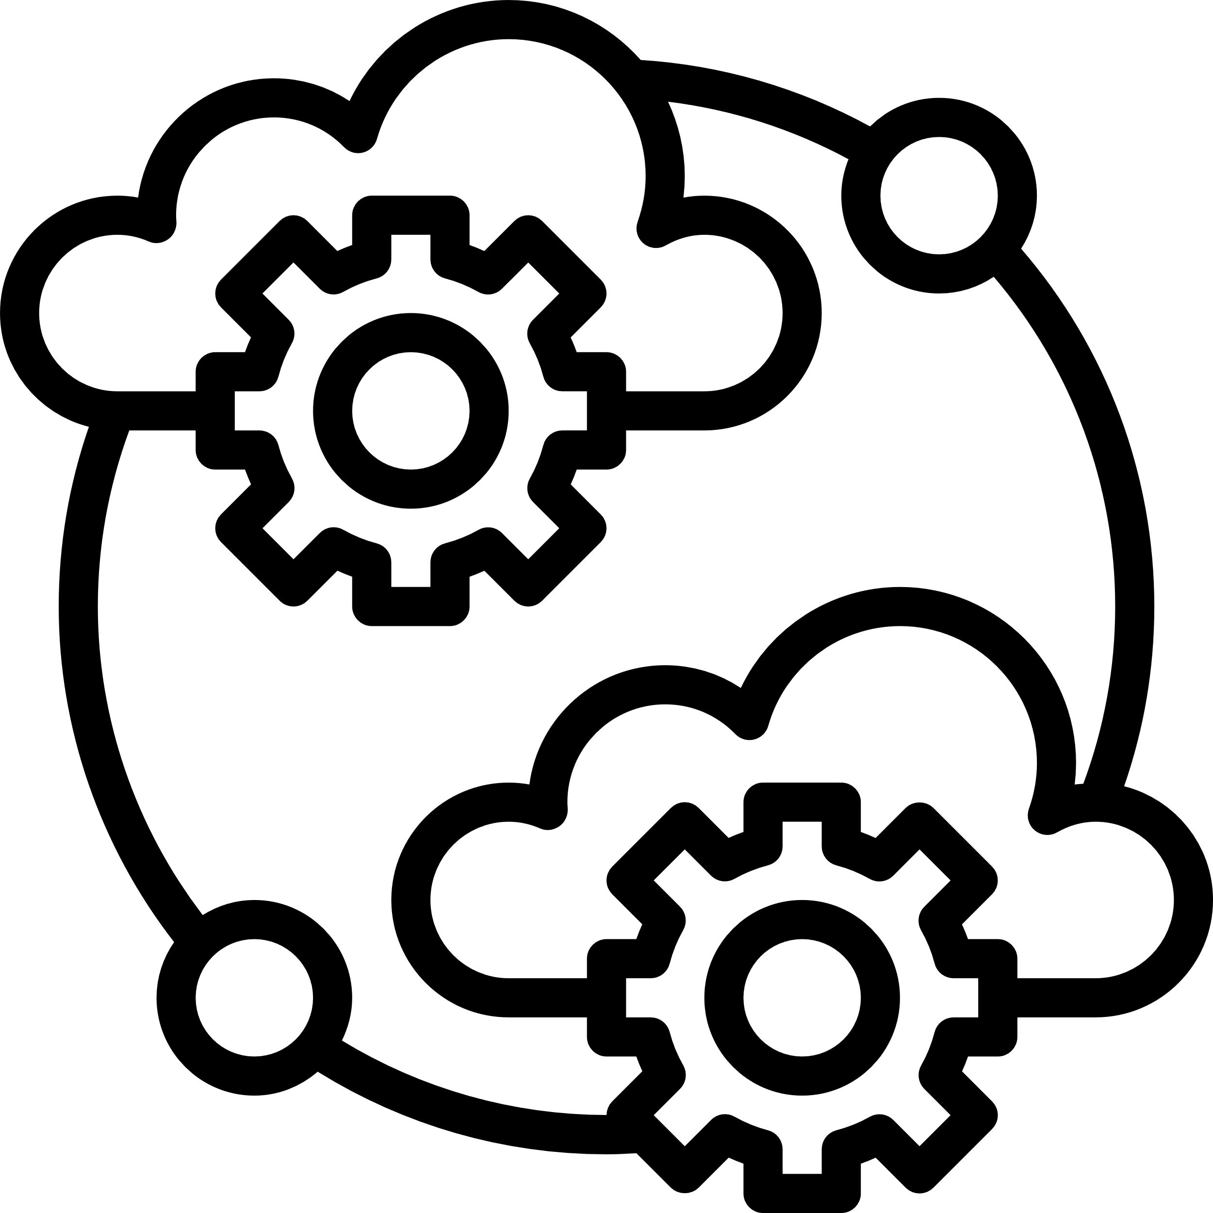
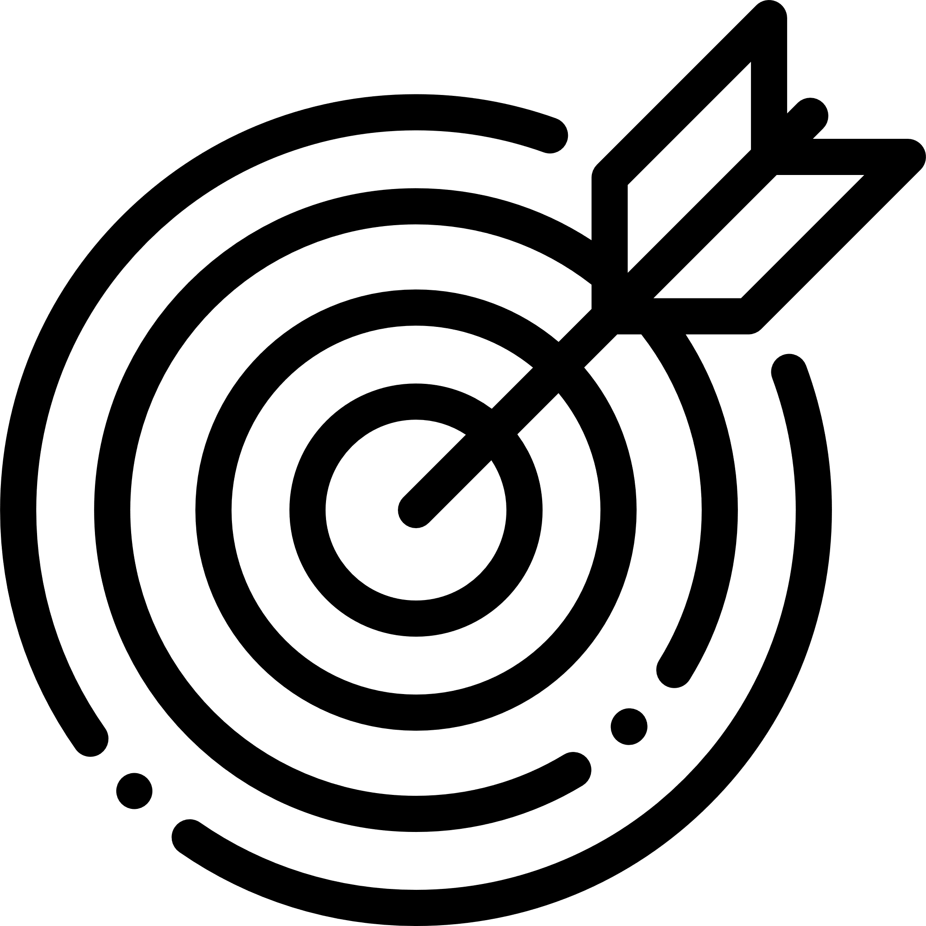
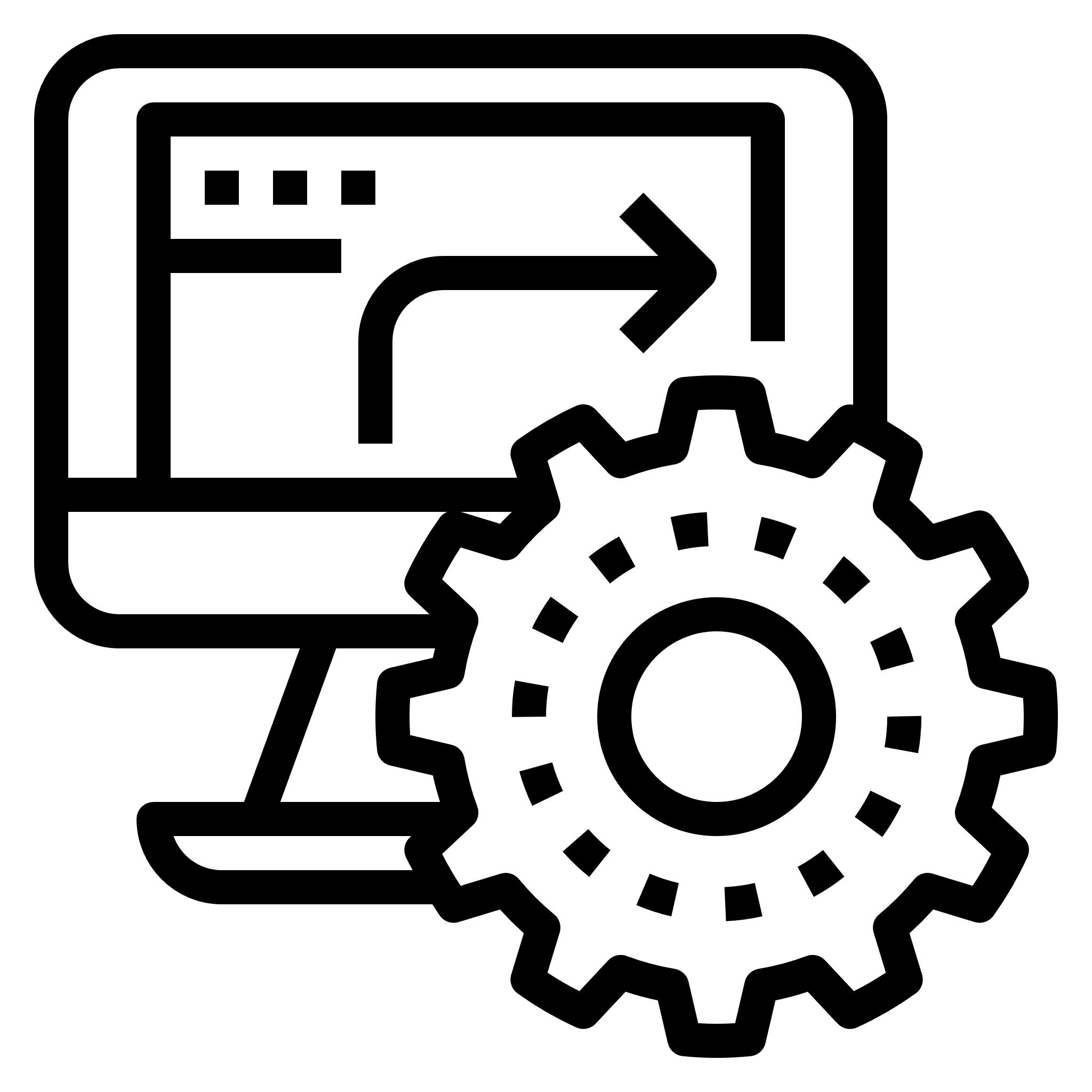
Differentiator
E2E Solution
Public Cloud Partnership
Open-Source Contribution
Single point of contact for
Application Migration,
Transformation and Integration
to cloud-native Apps services
Our advanced partnership
with major public cloud
providers help you to get
support at every stage
Committed to codifying
our know-how, we write open
Products and Distribute
Optimization Service
Engagement Model
Extreme Automation
We do optimal resource pooling
from multiple clouds
Our every engagement
focused on empowerment
– not dependency
Use our existing automation
capabilities to automate
infrastructure, operations,
security in hybrid IT environment

Slide 5
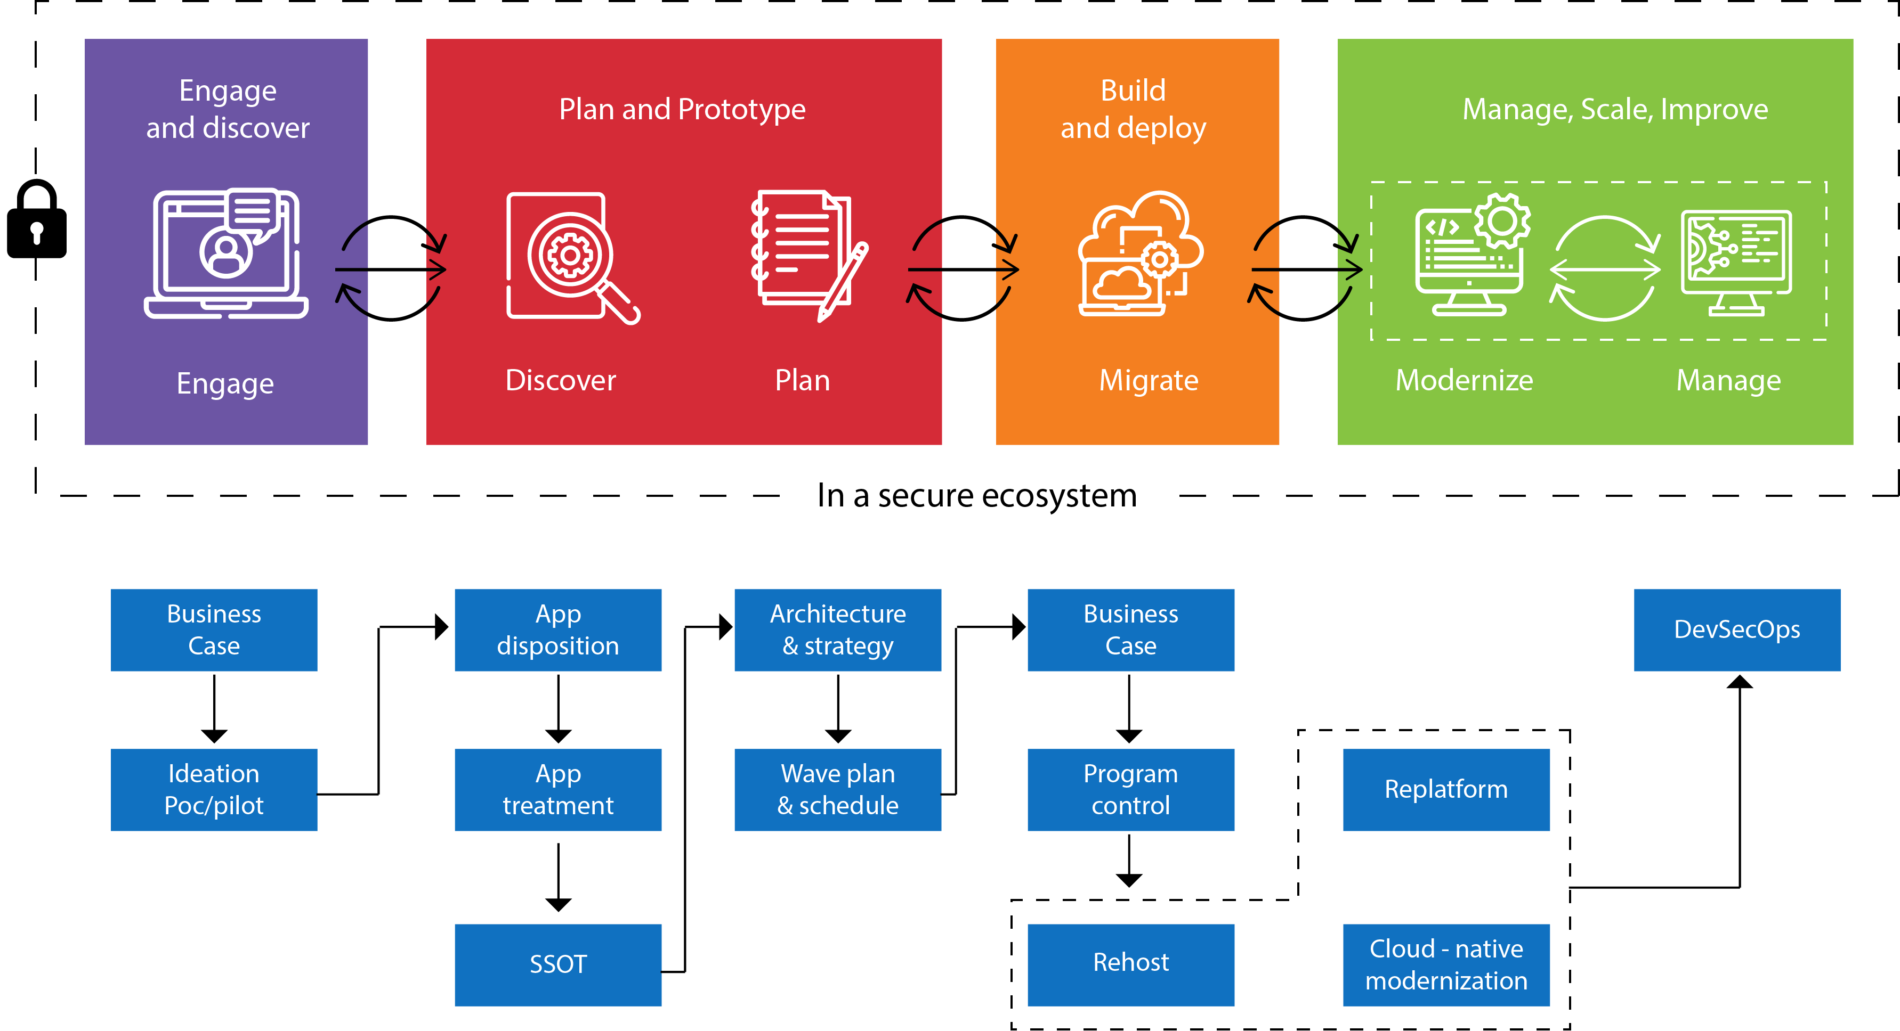
Engagement Model

Slide 6
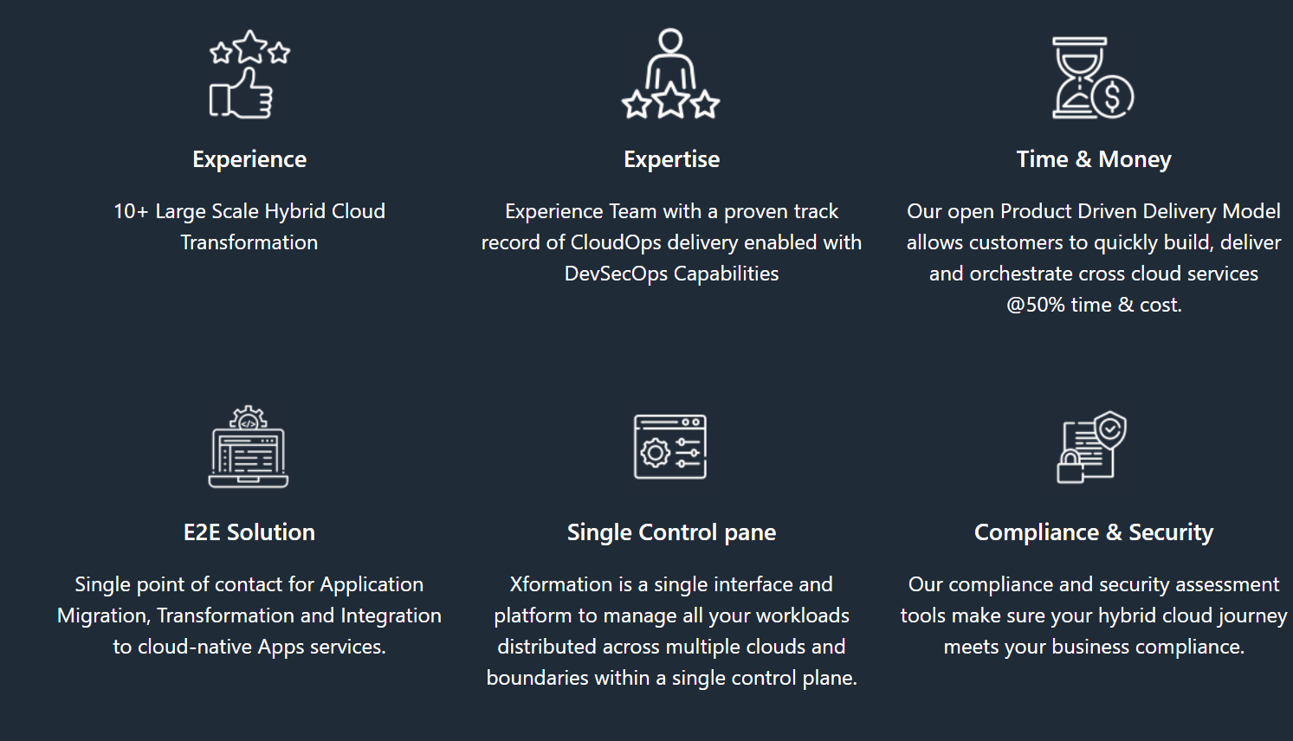
Case Studies

